Slide 1
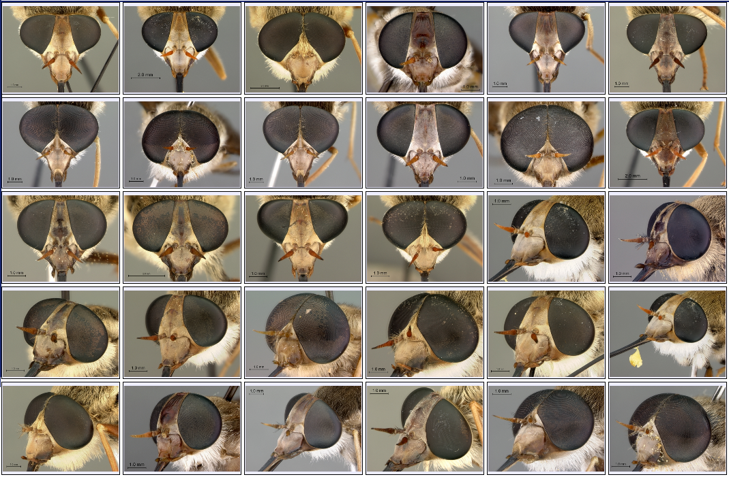
Morphbank Current Topics: Using Images & Metadata Biodiversity Informatics Course, 18 September 2009 Swedish Museum of Natural History (NRM), Stockholm

Slide 2
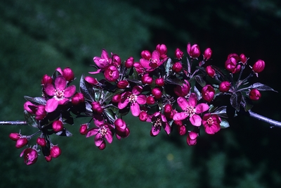
Topics
Morphbank Overview
Morphbank Object Model and Database Design
image, specimen, view, locality
identification (morphbank identifier and urls)
Connecting Morphbank Objects
Web Services (lecture / workshop)
Recent Examples
images
collections
kml files
Google Maps
publications
ontologies (CToL)
Metadata Organization and Management (lecture / workshop)
Coming up Next at Morphbank:
Specify Project (XML) (lecture)
Morphster (Ontologies) and OntoBrowser (lecture)
Integration of Morphster & Morphbank (lecture)
Open Source software (lecture)
Morphbank Upload via Web (workshop)
Upload via Morphbank Excel Workbook (workshop)
After the Upload (workshop)
Notes:
Topics covered in this presentation include 1) overview of how to upload objects via the morphbank.net, 2) how to populate the Morphbank Excel Workbook, 3) using Morphbank Collections, Annotations, web services, linking, rss, Google Maps after upload, 4) ontologies linked to images in Morphbank (using images in Morphbank to illustrate an ontology).

Slide 3

Acknowledgements
All Morphbank Contributors & Collaborators > CBG, AToL, PEET, PBI, MX, HERBIS, CToL, PlantCollections Project, SERNEC, FSU, PlatyPBI, SAIN, UAM, …

Slide 4
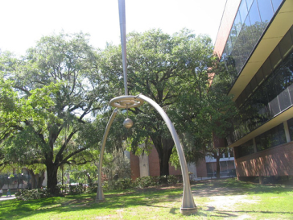

Morphbank Overview
Morphbank is first of all, an open web repository of biological images serving the research community. Any research biologist may contribute to and use Morphbank tools. Once images and associated data are in Morphbank,…
A variety of tools give any Morphbank Contributor the opportunity to add value to the existing data and images via links, annotations, collections, web services, …made possible by identifiers for each Morphbank Object.
First developed in 1998 by a Swedish-American-Spanish group of entomologists as an ftp site. Now centered at the Department of Scientific Computing (SC) and the College of Communication & Information at Florida State University
Repository of images of organisms
227,000 images so far
Each image has a context:
Specimen, taxon, locality, specimen part, view angle, etc.
Repository of information related to the images
Specimens, localities, users, groups, taxa, annotations, collections
Contributor, submitter, group, date, permissions
Unique identity for each object

Slide 5
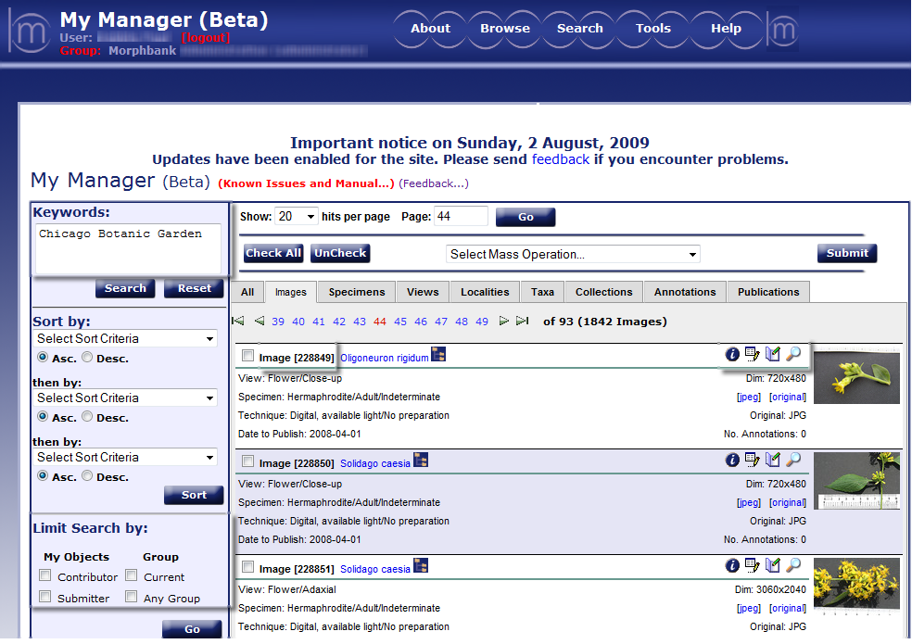
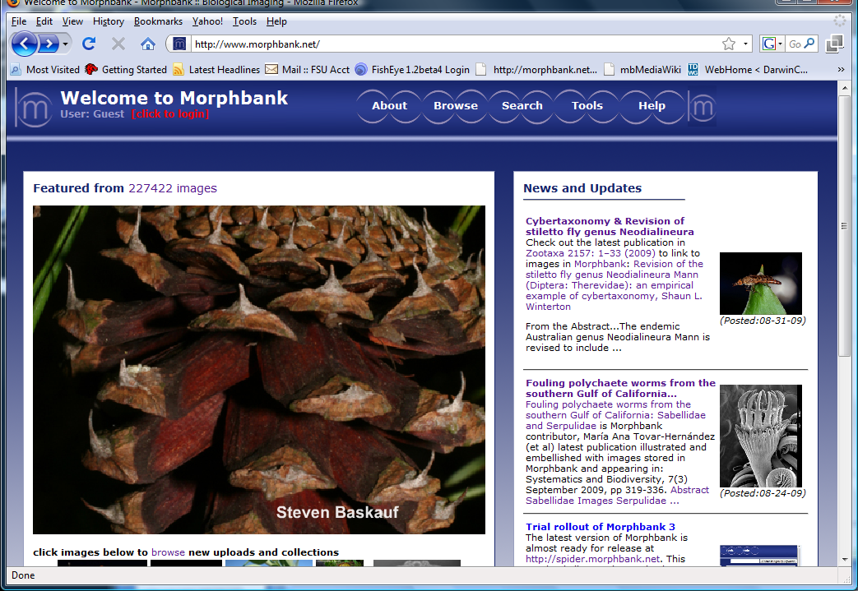
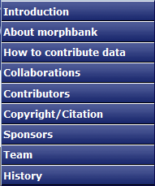
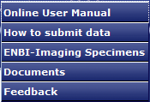
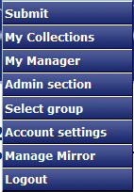
www.morphbank.net

Slide 6
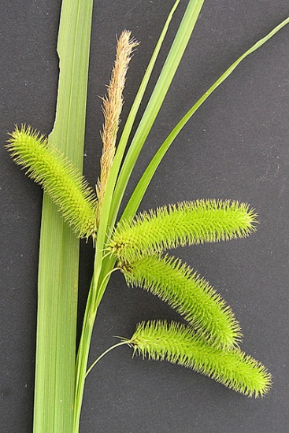
Morphbank Features
Browse / Search My Manager tabs – Each is a Morphbank Object
Keyword search via metadata from a Google-like search box
Limit search results to group / contributor
Security model
Private vs. public data (‘unpublished’ and ‘published’)
Contributor controls date-to-publish
Group access, group roles, user-managed
Upload & edit
Via Web, Excel Workbook, & XML (coming soon)
New Grant to develop a Specify client plug-in
User support
help desk
Online users manual and FAQ
Workshops for users and programmers

Slide 7
Database Design & the Morphbank Object Model
Morphbank is a relational database
Many of the fields are from Darwin Core
Why use a standard schema?
facilitate automated data-sharing aka interoperability
skip the reinvention step
reduce and / or reveal ambiguity
Why do I require an hour to give this lecture when all I have to say really could go into roughly six sentences?
Because I could not utter six sentences which were not so heavily charged with ambiguity that no one in the end would get the picture that I am trying to formulate.
Most human sentences are in fact aimed at getting rid of the ambiguity which you unfortunately left trailing in the last sentence.
–Jacob Bronowski, 1967
?

Slide 8
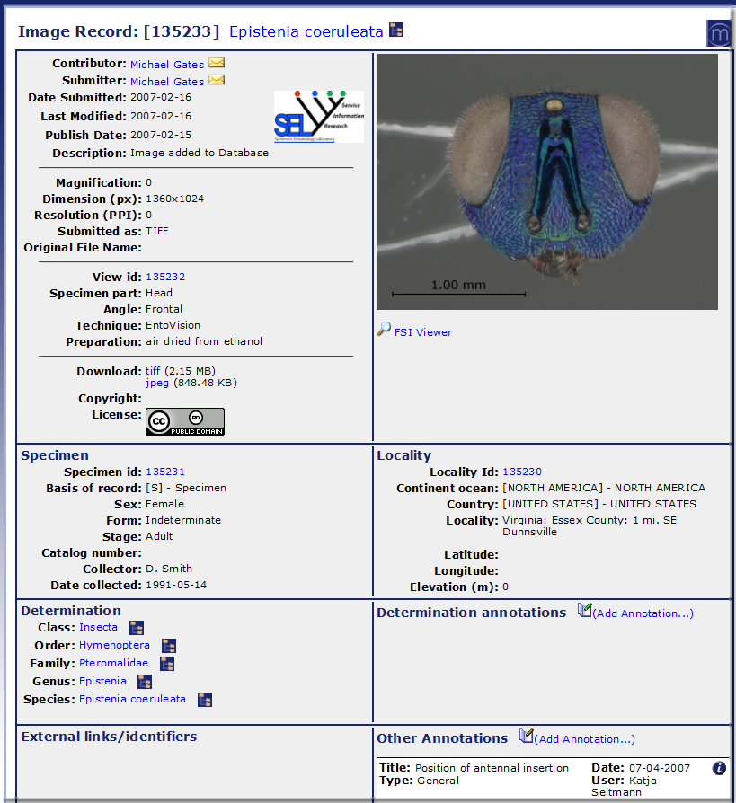
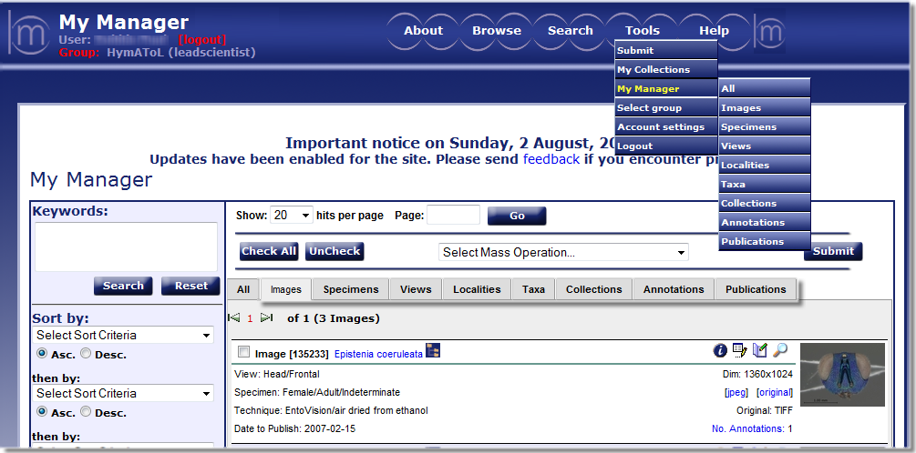
Morphbank Object Model
Main Objects in Morphbank
image
specimen
view
locality

Slide 9
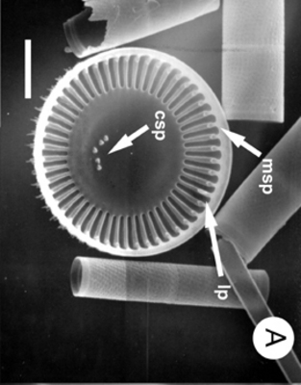
Morphbank Object Model
Objects have identifiers – Morphbank Ids
identification is key
key to linking
key to database interactions
example: service requests
updates and inserts
future: computer – to – computer data-sharing
external persistent identifiers
prefix + persistent id
Objects have relationships
Mb Unified Modeling Language (UML) Schema
http://www.morphbank.net/docs/mbUML.pdf

Slide 10
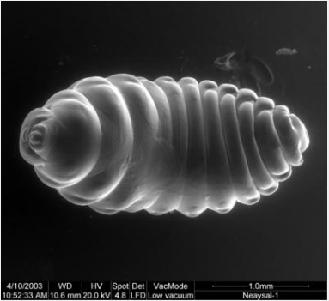
Morphbank Object Model
View
http://www.morphbank.net/Show/?id=72113
Image
67765
72113
Specimen
Locality
User
69887
67777
Group
18
Annotation/s
id/s
4
Collection/s
id/s

Slide 11
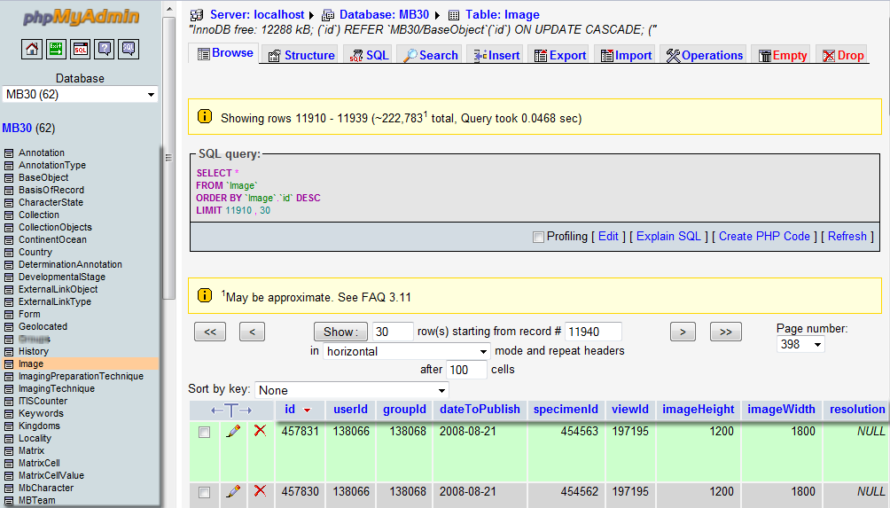
Morphbank Objects, Attributes & Values
A phpmyadmin View of Morphbank

Slide 12
Connecting Morphbank
After Upload > Web Services > Using a service for searching
retrieve ids for Morphbank objects
display geolocated Morphbank Specimens with GoogleMaps
output data in XML format
create custom RSS feeds, Google Reader
Embedding links in Web pages, documents
Connecting Morphbank Objects
Recent Examples of Publications linking images, collections, kml files, Google Maps and ontologies

Slide 13
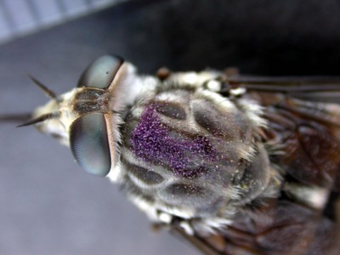
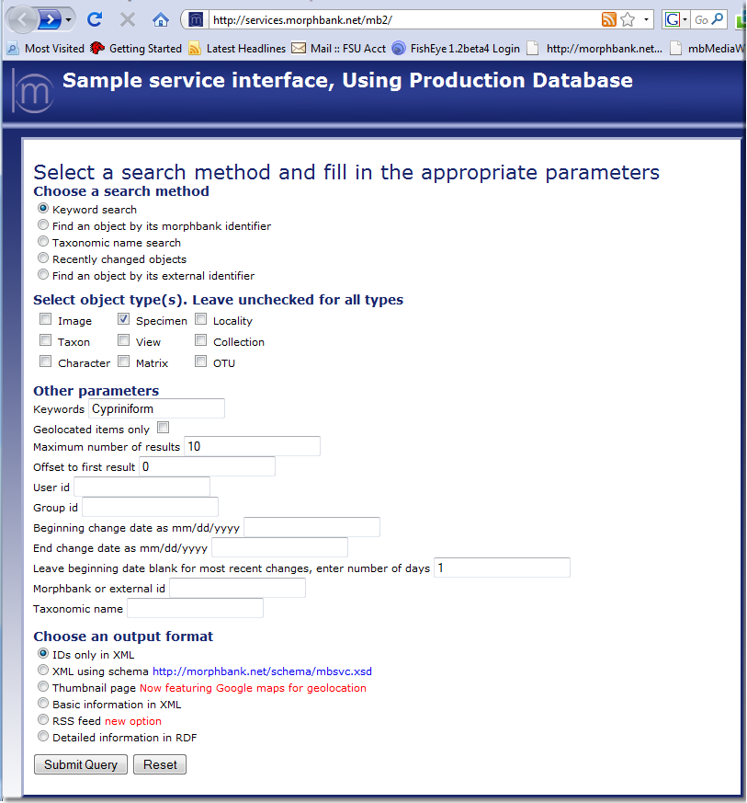
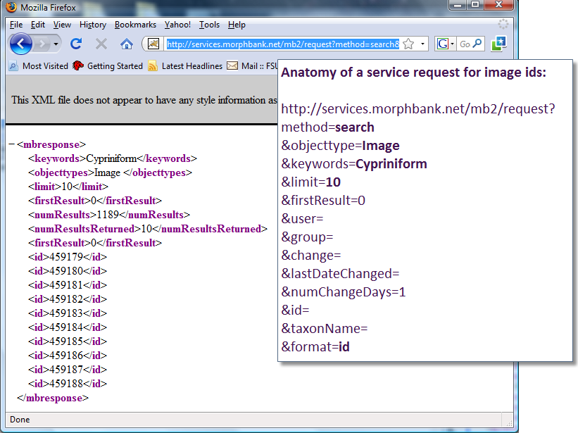
Web Services
http://services.morphbank.net/mb2/
Creates a database query
see the API
Returns output in format selected
Keep up with the latest changes
Allows dynamic searching
Notes:
Note if using this ppt slide, the http:// address to services above is a hot link to the services page.
This example uses: Keyword search, object type = Image, Keyword = CToL, Max results = 10, output = Ids in XML format.
When SCAMIT has many images in Morphbank, this type of search will be done whenever a user clicks on the SCAMIT pages. The ids themselves will be part of a dynamically contructed URL to retrieve the images to display as well as form the links back to Morphbank. Example: Using Keyword = SCAMIT, select Image as object type, Keyword search and ask for output = IDs only in XML. A list of ids is returned. Once the SCAMIT web pages are built, the requests are in the pages and the images are retrieved on-the-fly, aka dynamically, each time someone loads the SCAMIT page in their browser.
The above slide shows the IDs in XML format. If a user of Morphbank does a Keyword search via the Web interface, the first 10 records will be the same.

Slide 14
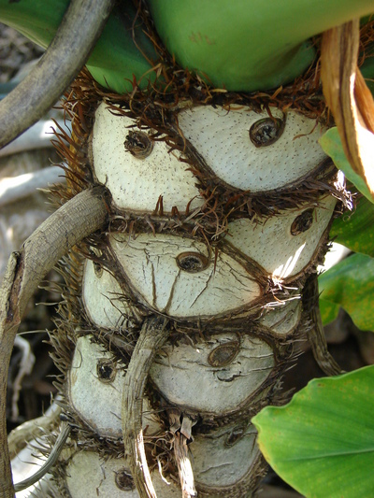
Morphbank Ids and Linking
How to format links to Morphbank
Retrieve mb ids via services.morphbank.net/mb2/
base url + identifier
http://www.morphbank.net/?id=464656 image record ss
http://www.morphbank.net/Show/?id=464656 image record ss
http://www.morphbank.net/?id=478331 collection ss
http://www.morphbank.net/myCollection/?id=478331 collection ss
http://www.morphbank.net/myCollection/?id=474239 collection ss
base url + identifier + image type
http://www.morphbank.net/?id=464091&imgType=tiff image
http://www.morphbank.net/?id=464091&imgType=jpeg image
http://www.morphbank.net/?id=464091&imgType=jpg image
http://www.morphbank.net/?id=464091&imgType=thumb image
http://www.morphbank.net/?id=464091&imgType=jpeg&imgSize=500 image

Slide 15
Using Links back to Morphbank in …
publications
Winterton, Shaun. Revision of the stiletto fly genus Neodialineura Mann (Diptera: Therevidae): an empirical example of cybertaxonomy. Zootaxa 2157: 1–33 (2009)
dynamic web services requests
Neodialineura Specimens on Google Maps via Morphbank web services
html
<a href=“http://www.morphbank.net/?id=477811” target=blank>Malus sieboldii var. arborescens</a>
http://www.tolweb.org/Alobevania/120177
keys
Morphbank Keyword Search: Handbook to Nearctic Chalcidoidea
http://www.hymatol.org/Chalcidkey/index.php
http://morphbank.net/Show/?id=228786
http://morphbank.net/?id=111285
kml files > Google Earth > Morphbank geolocated Specimens
http://dx.doi.org/10.3897/zookeys.11.160-app.C.dt

Slide 16
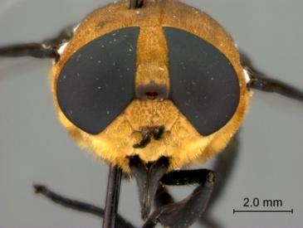
Using External Links
Morphbank Objects linking to External Documents
publications: http://www.morphbank.net/Show/?pop=Yes&id=464651
keys: http://www.morphbank.net/Show/?pop=Yes&id=134316
GenBank:
http://www.morphbank.net/Show/?pop=Yes&id=135299
http://www.morphbank.net/Show/?pop=Yes&id=135288
Ontologies:
TAO Ontology http://www.morphbank.net/Show/?id=459179
http://bioportal.bioontology.org/virtual/1110/TAO:0001279

Slide 17
Metadata Organization & Management
Taxonomic Names
File names in general
Image file names
Data cleaning
Relating Data and Images to Morphbank Objects aka Understanding the Data Model

Slide 18
Metadata Organization & Management
Taxon Names in Morphbank
not a taxonomic name server
currently, 3 ways to upload names
via web (at rank sub-order & lower)
via the Morphbank Excel Workbook (species and lower)
via a Taxon Upload Excel worksheet (all ranks)
check that names match
2 ways
future plan
may have a name field (string?) only
parentage indicated in a separate field
contributors link to their own taxonomy or taxonomy of choice

Slide 19
Metadata Organization & Management
File names
avoid spaces in directory names, …
Scorpion Head SEM → ScorpionHeadSEM or Scorpion_Head_SEM
Image file names
no spaces here either
stay away from possible reserved characters like & $
langer 060929 &0557 Leptecophylla tameiameiae-habitat view PCH.jpg
use a consistent naming strategy
use numbers to name photos
store data about the photograph in the EXIF
let the camera number the images

Slide 20
Metadata Organization & Management
Data cleaning
is it unique?
mysql & phpmyadmin vs. Excel
spelling?
typographical errors
do image file names in workbook match file names in the ftpsite?

Slide 21
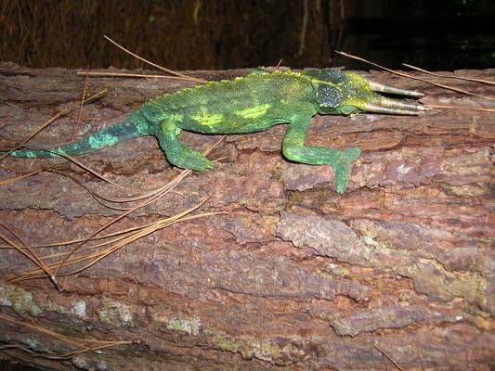
Metadata Organization & Management
Relating Data and Images to Morphbank Objects aka Understanding the Data Model
image, specimen, view, locality, user/contributor, submitter, group
keep the socks in the sock drawer

Slide 22
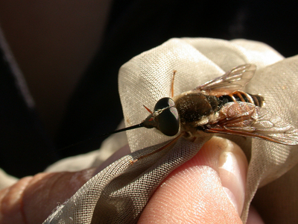
Submission
Three submission strategies
Web forms
Login, choose submit, fill in form, upload image
Excel spread sheet
Put metadata into a spread sheet
Copy images via ftp
Send spreadsheet to Morphbank
Morphbank personnel carry out the upload
XML service
Export metadata from your database/spreadsheet in XML
Send XML to Morphbank
Copy images via ftp or http
More about XML to come (user properties)
Coming:
Upload from Specify or other metadata catalog

Slide 23
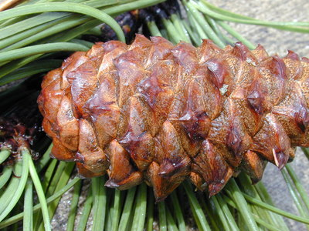
Future Directions
New project collaborations (NSF funding)
Morphbank Morphster Specify
Integration of Ontology
Sharing information between systems
Fully distributable, installable image repository
Open Source

Slide 24
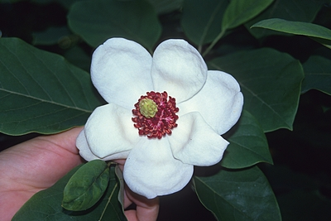
A bit about Ontologies
The Morphbank Data Model revised
SpiderAToL > linking images and ontologies > http://spider.begoniasociety.org/projects/1/public/tree
The Open Biomedical Ontologies OBO Foundry
SpiderAToL > Spider Ontology
CToL > Teleost anatomy and development
OntoBrowser, Morphbank, Morphster > linking images and ontologies

Slide 25
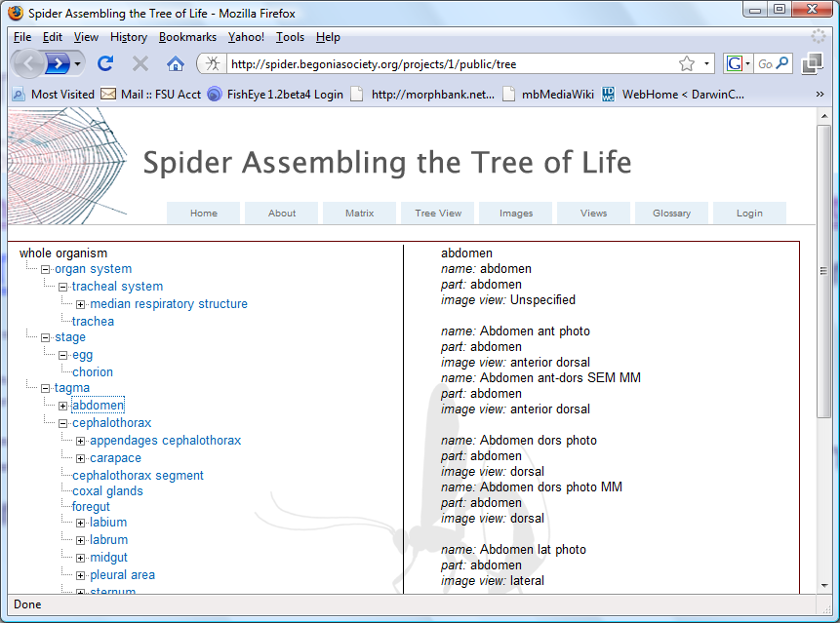

Slide 26
Morphbank Object Model*
Related View
View
http://www.morphbank.net/Show/?id=72113
Image
67765
72113
Specimen
Locality
User
69887
67777
Group
18
Annotation/s
id/s
4
Collection/s
id/s

Slide 27
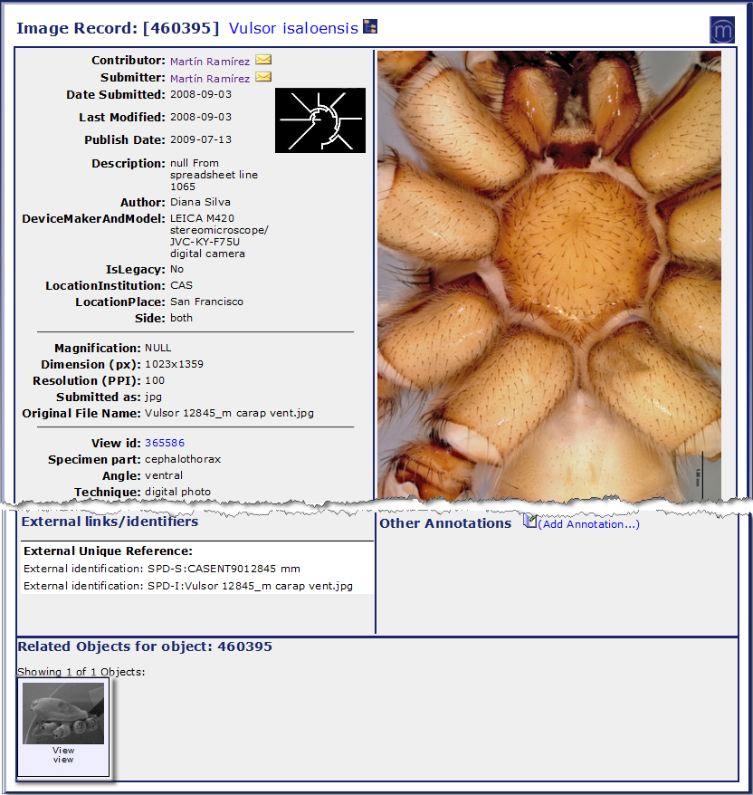
A bit about Ontologies
Related objects within Morphbank
modifying the data model to work with ontologies
SpiderAToL example
http://www.morphbank.net/Show/?pop=Yes&id=460395

Slide 28
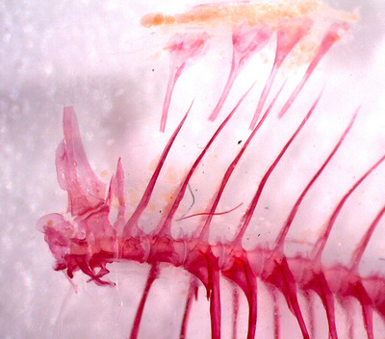
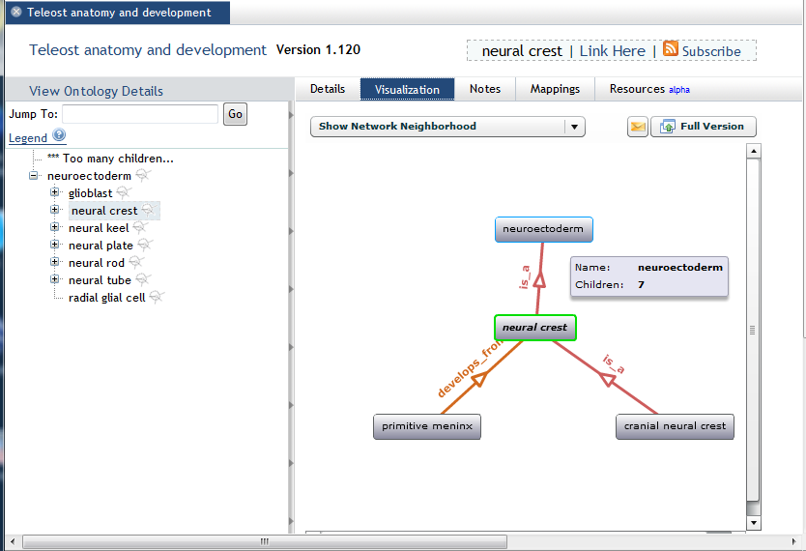
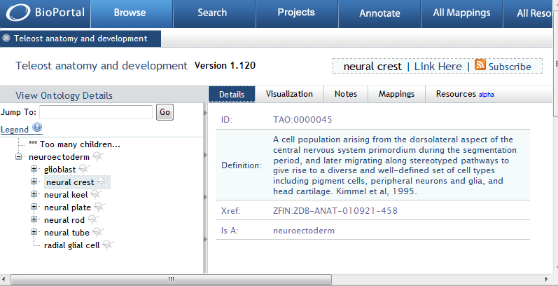
A bit about Ontologies
Related objects within Morphbank
CToL example
http://www.morphbank.net/Show/?pop=Yes&id=459818

Slide 29
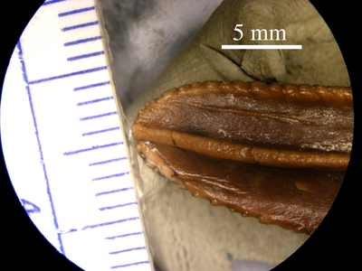
Morphbank+Morphster+Specify
Specify (Beach, U. Kansas)
Specimen management
Desktop tool for specimen metadata management
Morphster and Ontobrowser (Miranker, U. Texas)
Ontology Management for Phylogenetics
Extension of ontology to incorporate annotations
Integration of Specify, Morphster and Morphbank
Searching for images using ontology terms
Linking images and other digital objects to ontology terms
Access to information from any user interface

Slide 30
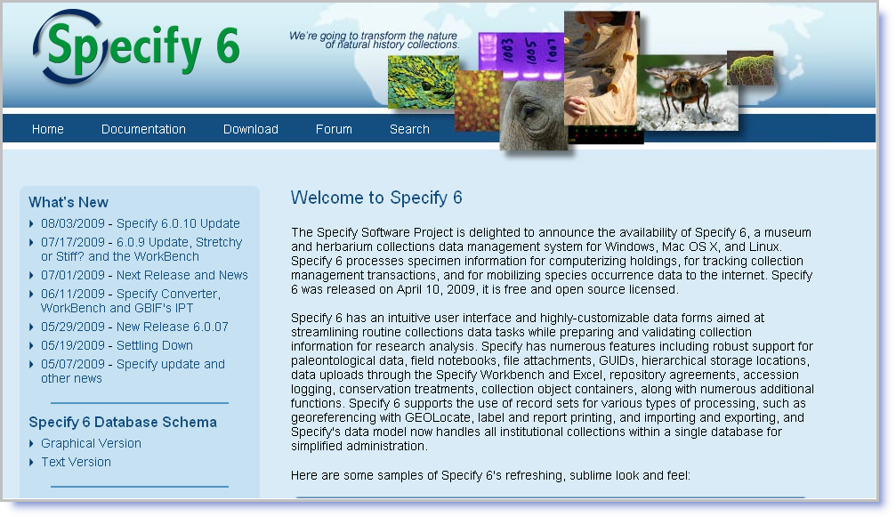

Slide 31
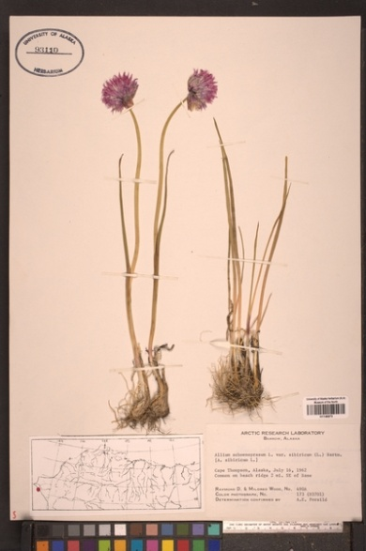
Morphster Project
Dan Miranker at U. Texas at Austin
Ferner Cilloniz and other students
NSF funding
Morphster is an ontology management system
Desktop application
Import and transform various ontology representations
Image annotation
Ontobrowser is a Web site
Browse ontology terms
Illustrate ontology terms with images

Slide 32
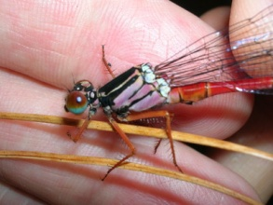
Illustration of Ontology
Associate feature that can be seen in an image with ontology terms that describe the image
Area of interest in the image
Terms that describe anatomy, shape, etc.
Replace
The (un) controlled vocabulary of Morphbank
With the controlled vocabulary of Morphster
Resulting system is
Better for users because it is illustrated
Better for harvesters because it is precise

Slide 33
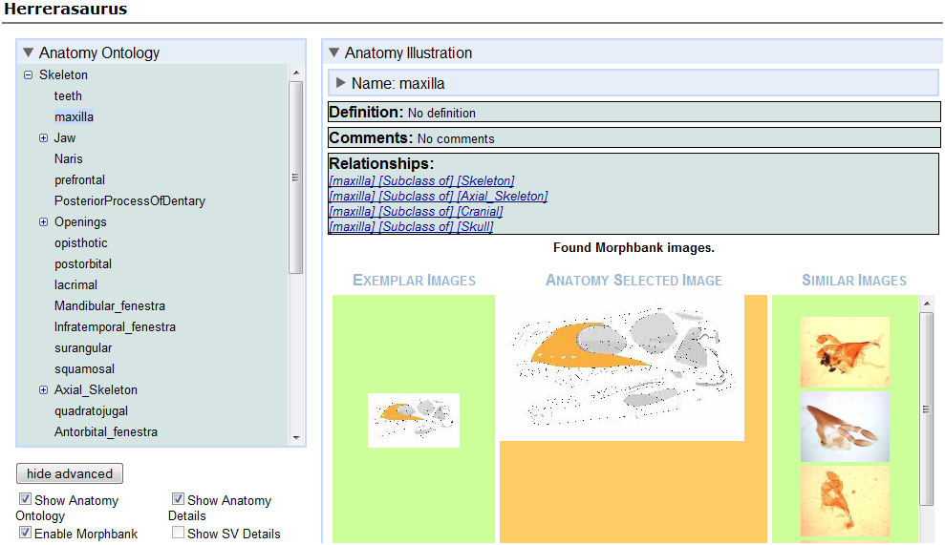
Ontobrowser with Morphbank

Slide 34
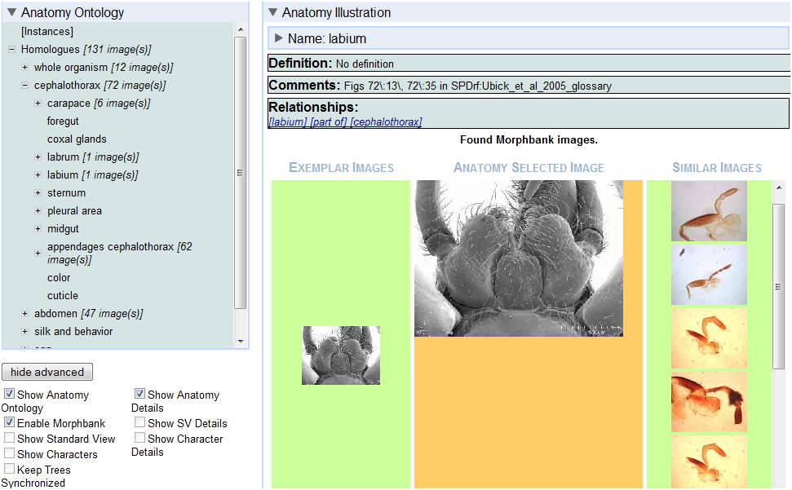
Ontobrowser with Morphbank

Slide 35
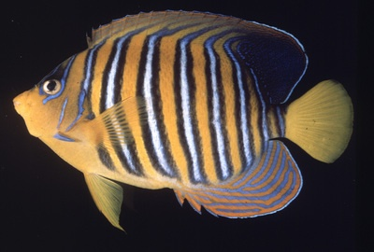
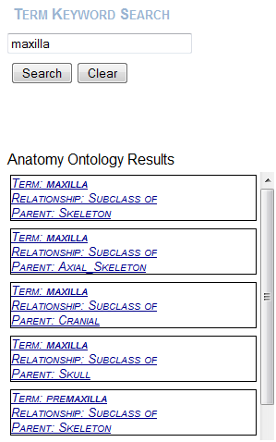
Try Ontobrowser
http://www.morphster.org:8080/OntobrowserV3/
An example search:
Select ontology Herrerasaurus
Click the "Show Advance" button and select
"Enable-> Morphbank".
Go to the "Term Keyword Search“
on the right and search for maxilla.

Slide 36
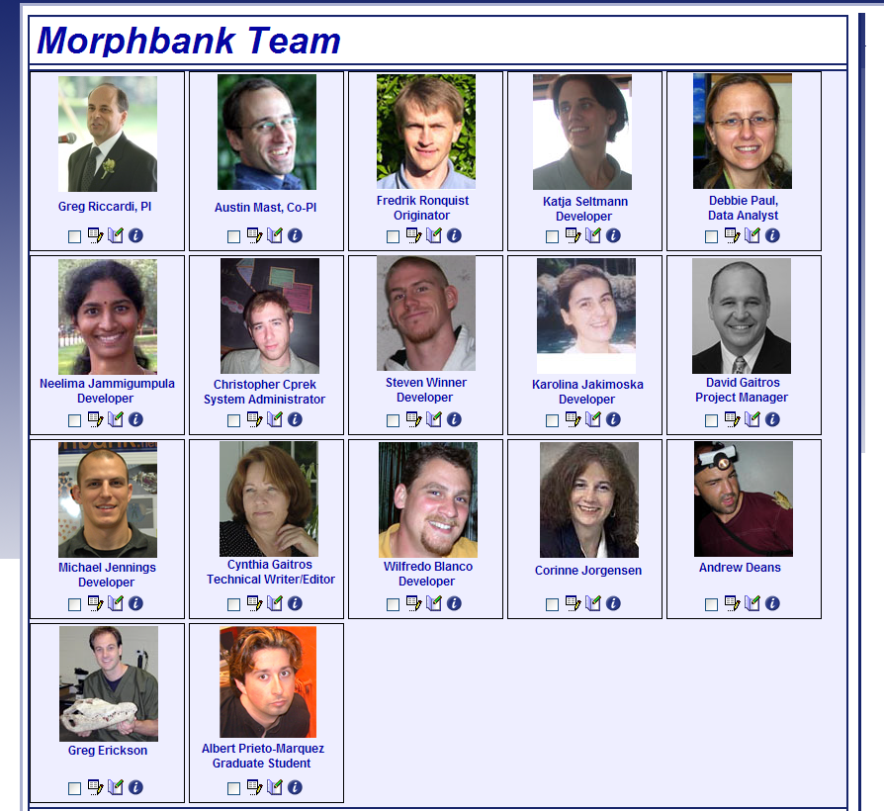
Thanks from the Morphbank Team
Steven Winner
Katja Seltmann
Fred Ronquist
Greg Riccardi
Albert Prieto-Marquez
Debbie Paul
Austin Mast
Corinne Jorgensen
Michael Jennings
Neelima Jammigumpula
Karolina Jakimoska
David Gaitros
Cynthia Gaitros
Greg Erickson
Andrew Deans
Christopher Cprek
Wilfredo Blanco

Slide 37
Morphbank Uploads: focus on the Excel option Biodiversity Informatics Course, 18 September 2009 Swedish Museum of Natural History (NRM), Stockholm

Slide 38
Morphbank Upload via Web
Images for 2 or more different specimens
Learn Morphbank (Darwin Core) fields
Experience Morphbank features
Collections, annotations, edit, link, character states
Taxonomic Names
Image preparation issues
Image file names, file types, views
Notes:
Uploading via the web, before submitting medium to large datasets to Morphbank facilitates the learning curve for data/image submission. Users having experience with the user-interface are familiar with Morphbank fields and objects (image, view, locality, specimen, annotation, collection, group, user, contributor, submitter). Working with the Taxon Search in Morphbank teaches contributors how to find out what taxon names are in Morphbank and one method for adding taxon names. Once users input data for at least 2 different specimens and then upload images for those specimens, a given contributor will have a basic working knowledge of the Morphbank data fields (mostly Darwin Core). Whether planning to submit large datasets in the future, via xml or in the next week, via the Morphbank Excel Workbook, being familiar with Morphbank fields reduces error, exposes issues to be addressed before upload (data-cleaning) and speeds up the learning curve for figuring out the Excel Workbook. Images to be uploaded have to be described in some manner. Morphbank Images have a View; information that can be in a view includes: specimen part/s, view angle, imaging technique, imaging preparation technique, sex, form, developmental (life) stage and view applicable to taxon. Basic issues often arise at this point in the process such as: names of the images (are they unique?), and what type are they (example: Greyscale tiff will become negative – need to convert to Greyscale RGB). More can be found about Image Preparation in the online manual.

Slide 39
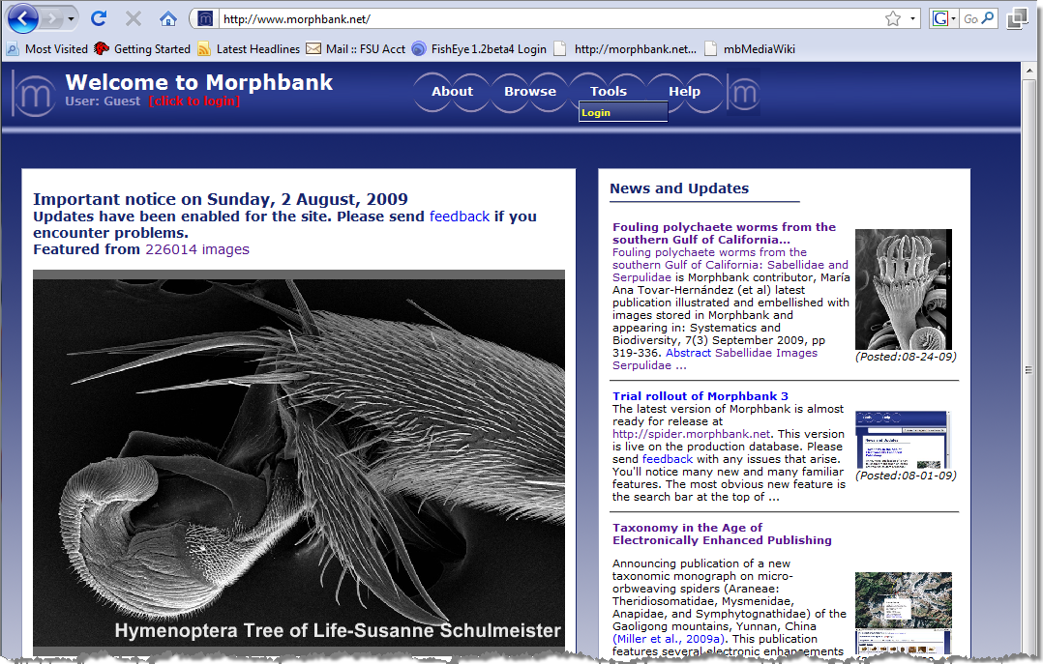
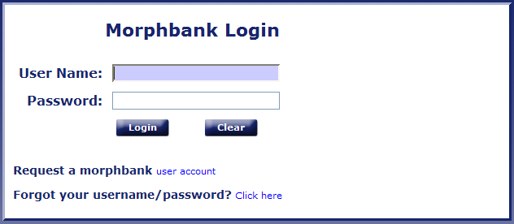
Morphbank Upload via Web
Tools > Login > Request user account
Notes:
From the front page of Morphbank, note the news items which often have links to collections in Morphbank as well as links to kml files and published journal articles. See Taxonomy in the Age of Electronically Enhanced Publishing. Note what drop-down choices are after login (they change). See under Help for Documents and Manuals. Look under Tools for how to submit via the web.

Slide 40
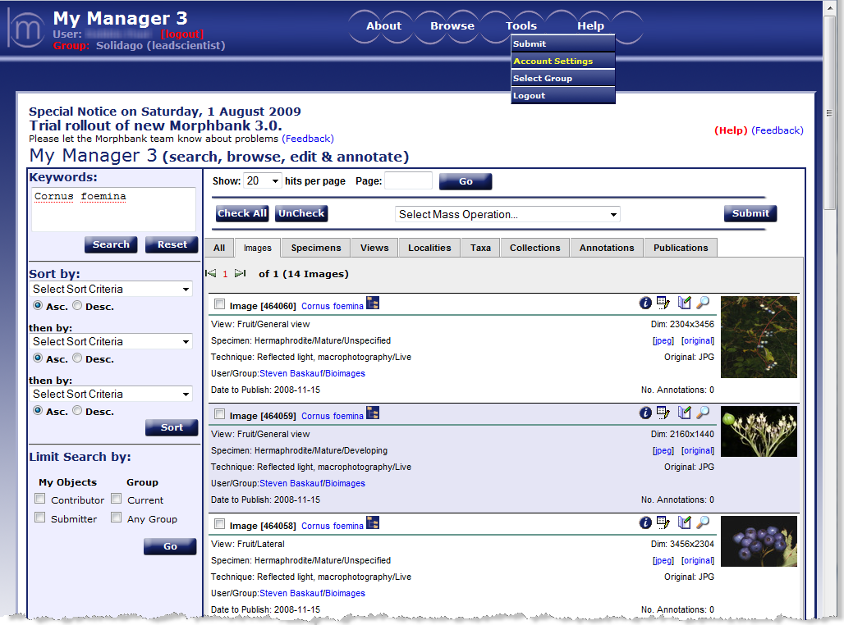
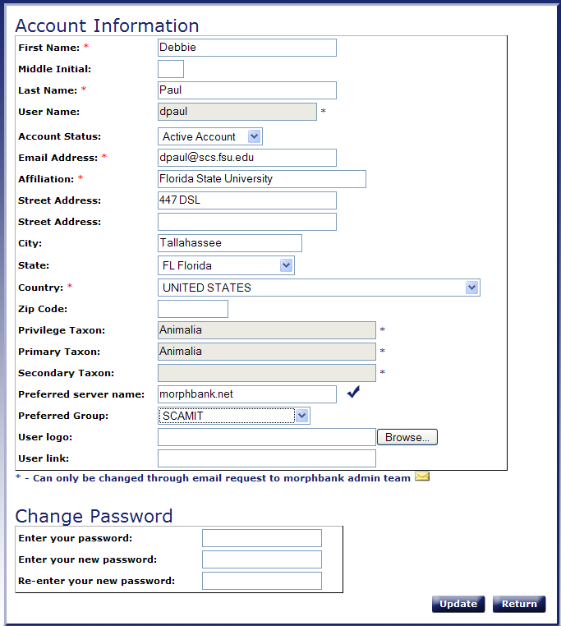
Morphbank Upload via Web
Login > Tools > Account Settings

Slide 41
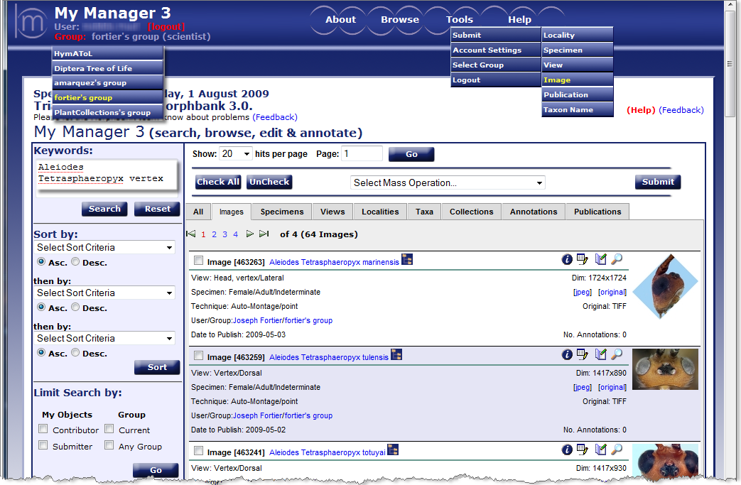
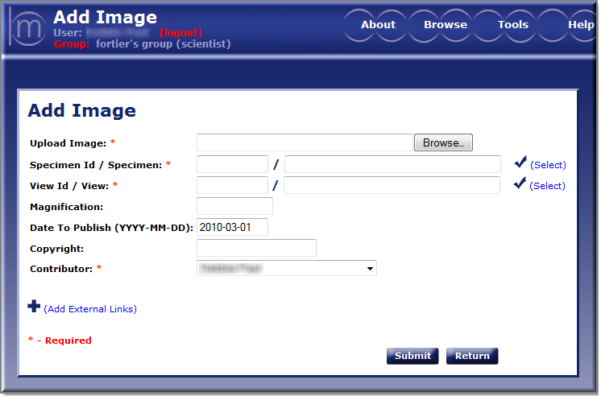
Morphbank Upload via Web
Check Select opens a pop-up.
Choose an existing Object or
Add a new one.
Image_one.imagetype
Notes:
On this slide, once logged in, note one can change groups with a click. Every object in Morphbank is associated with a group. Choose the desired group before uploading any Morphbank object. In the Excel Workbook, this choice is made on the very first worksheet in the workbook. All the objects in a given workbook are associated with one Morphbank Group. We’ll take a minute here to look at the features on the Image tab of the My Manager interface. Note Help (online user manual), Feedback (please), the “i” icon to see metadata, Edit/Annotation Icons, Keyword Searching (boolean AND, one table in the database and wild-carded terms), Limit Search by. Next, Add Image (which needs a Locality, View, Specimen and Determination).

Slide 42
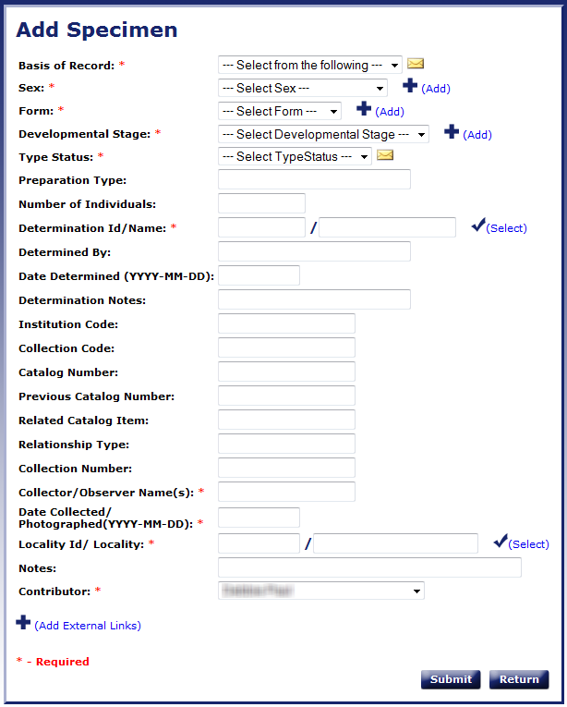
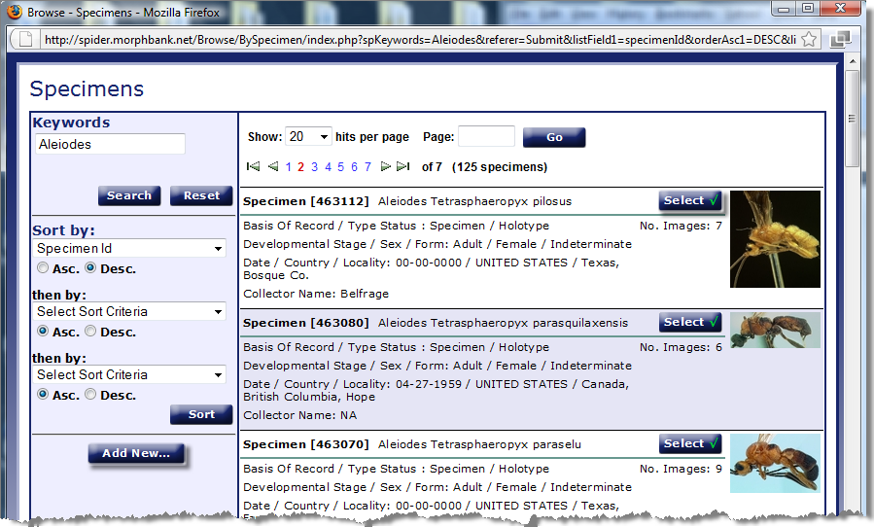
Morphbank Upload via Web
Click opens Browse / Add Specimen

Slide 43
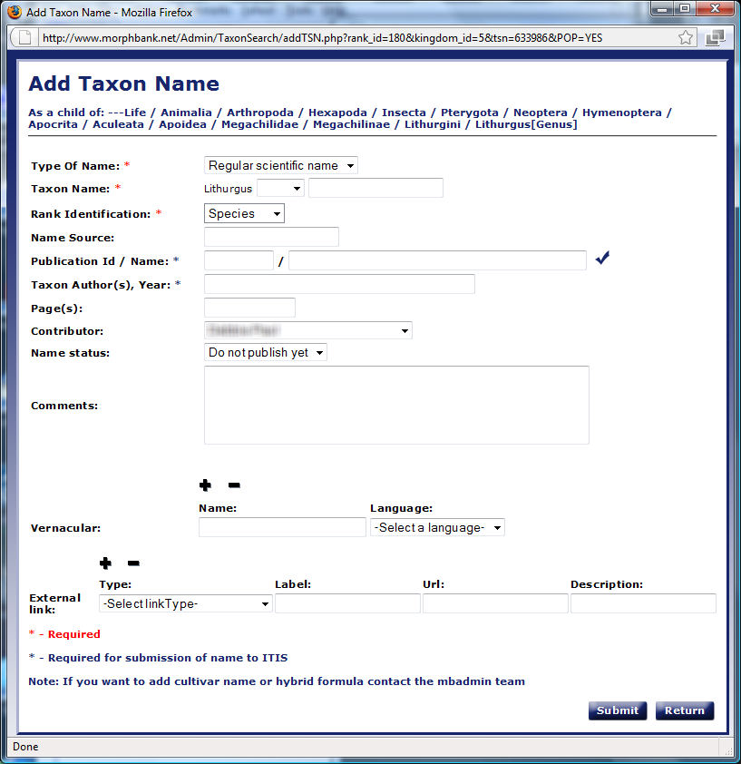
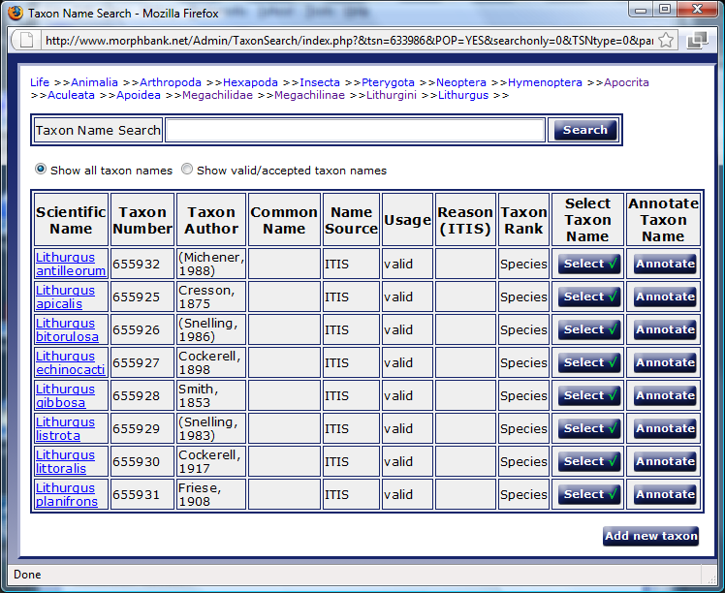
Morphbank Upload via Web
Click opens Search / Add Taxon Name

Slide 44
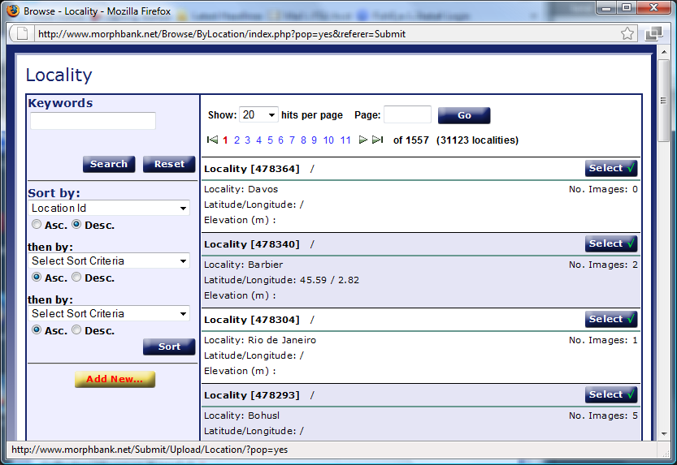
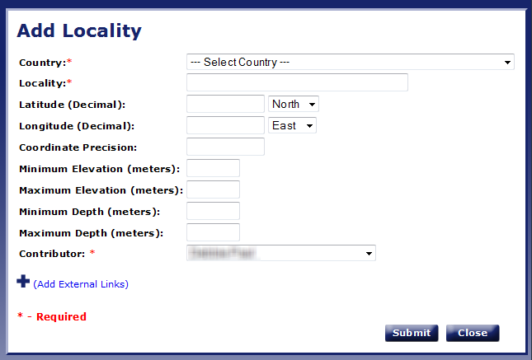
Morphbank Upload via Web
Click opens Browse / Add Locality

Slide 45
Morphbank Upload via Web
Now click to Submit Specimen
Then, to choose / Add View
665925
Lithurgus apicalis
Image_one.imagetype
500000
478364

Slide 46
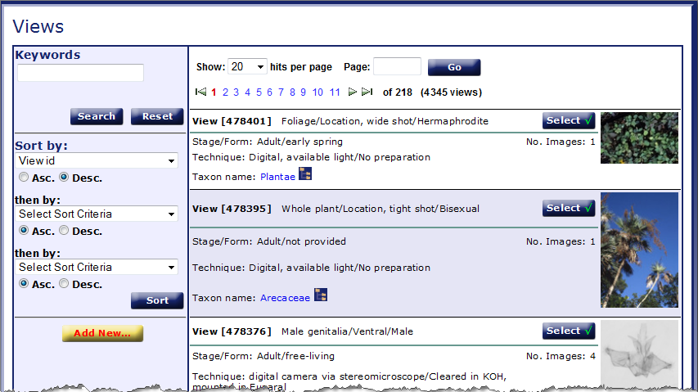

Morphbank Upload via Web
Search for an existing View or
Add View

Slide 47
Morphbank Upload via Web
Add Image > Specimen > View
Magnification and Copyright are optional
Date to publish > default or enter desired date
Choose Contributor from drop-down.
Click Submit
Image_one.imagetype
500000
500001

Slide 48
Morphbank Excel Workbook
Prepare before the Workbook
Data Cleaning
Workbook Caveat - changes may affect multiple sheets
Taxon Names
Check Morphbank: add names as needed (via web, via workbook, via mbadmin)
Images
Image file names
Check image compatibility (tiff grayscale)
FTP
Views
Specimen Information including Locality data
Morphbank
Contributor Name
User Name
Submitter Name
Date to publish images
External Links (project, institution, genbank, zootaxa, keys…)
Logo
Workbook appropriate for 100 – 250 images / upload
Notes:
A general overview of the issues to consider / decide before upload and a checklist of the items that need to be gathered.

Slide 49

Morphbank Excel Workbook
Image Collection worksheet

Slide 50

Morphbank Excel Workbook
Supporting Data worksheet
Multiple Drop-downs
Add terms to any given drop-down using this sheet
If many new terms are needed (e. g. for an ontology)
Data > Data Validation and Formulas > Name Manager*

Slide 51

Morphbank Excel Workbook
Locality Worksheet

Slide 52

Morphbank Excel Workbook
Specimen Taxon Data worksheet
Check names in Morphbank > Taxon Search or Name Query
Add names via Web > rank Sub-order or lower
Add names via Specimen Taxon Data worksheet > rank species or lower
Add many names > contact mbadmin
Column A – G > parents of Column H
Add one rank per row
Names in Column H create drop-down on Specimen worksheet
*If Names needed are already in Morphbank
Column A (Family) and Column H (Scientific Name String) only
Scientific Name String must match exactly

Slide 53

Morphbank Excel Workbook
Specimen Taxon Data
Sample worksheet
Names in Column H > appear in Specimen worksheet drop down

Slide 54



Morphbank Excel Workbook
Specimen worksheet

Slide 55


Morphbank Excel Workbook
My View worksheet

Slide 56

Morphbank Excel Workbook
Images worksheet

Slide 57
Morphbank Excel Workbook
FTP completed workbook and images to
hostname > ftp.morphbank.net
contact mbadmin@scs.fsu.edu for
ftp username and password
Use Web services > http://services.morphbank.net/mb2/ to
retrieve Morphbank Ids
create RSS feeds
Create Google Maps of geolocated Morphbank Specimens
output Morphbank Data in XML
In Morphbank > post upload possibilities > use ids to
create collections
make annotations
illustrate characters
create OTUs
use LinkOut (GenBank)
create KML files
illustrate online keys
…

Slide 58

Where does the data go?
Penev L, Erwin T, Miller J, Chavan V, Moritz T, Griswold C (2009) Publication and dissemination of datasets in taxonomy: ZooKeys working example. ZooKeys 11: 1-8. doi: 10.3897/zookeys.11.210

